Slide 1

ACO
Delivery Route Optimization
Using ant colony optimization

Slide 2

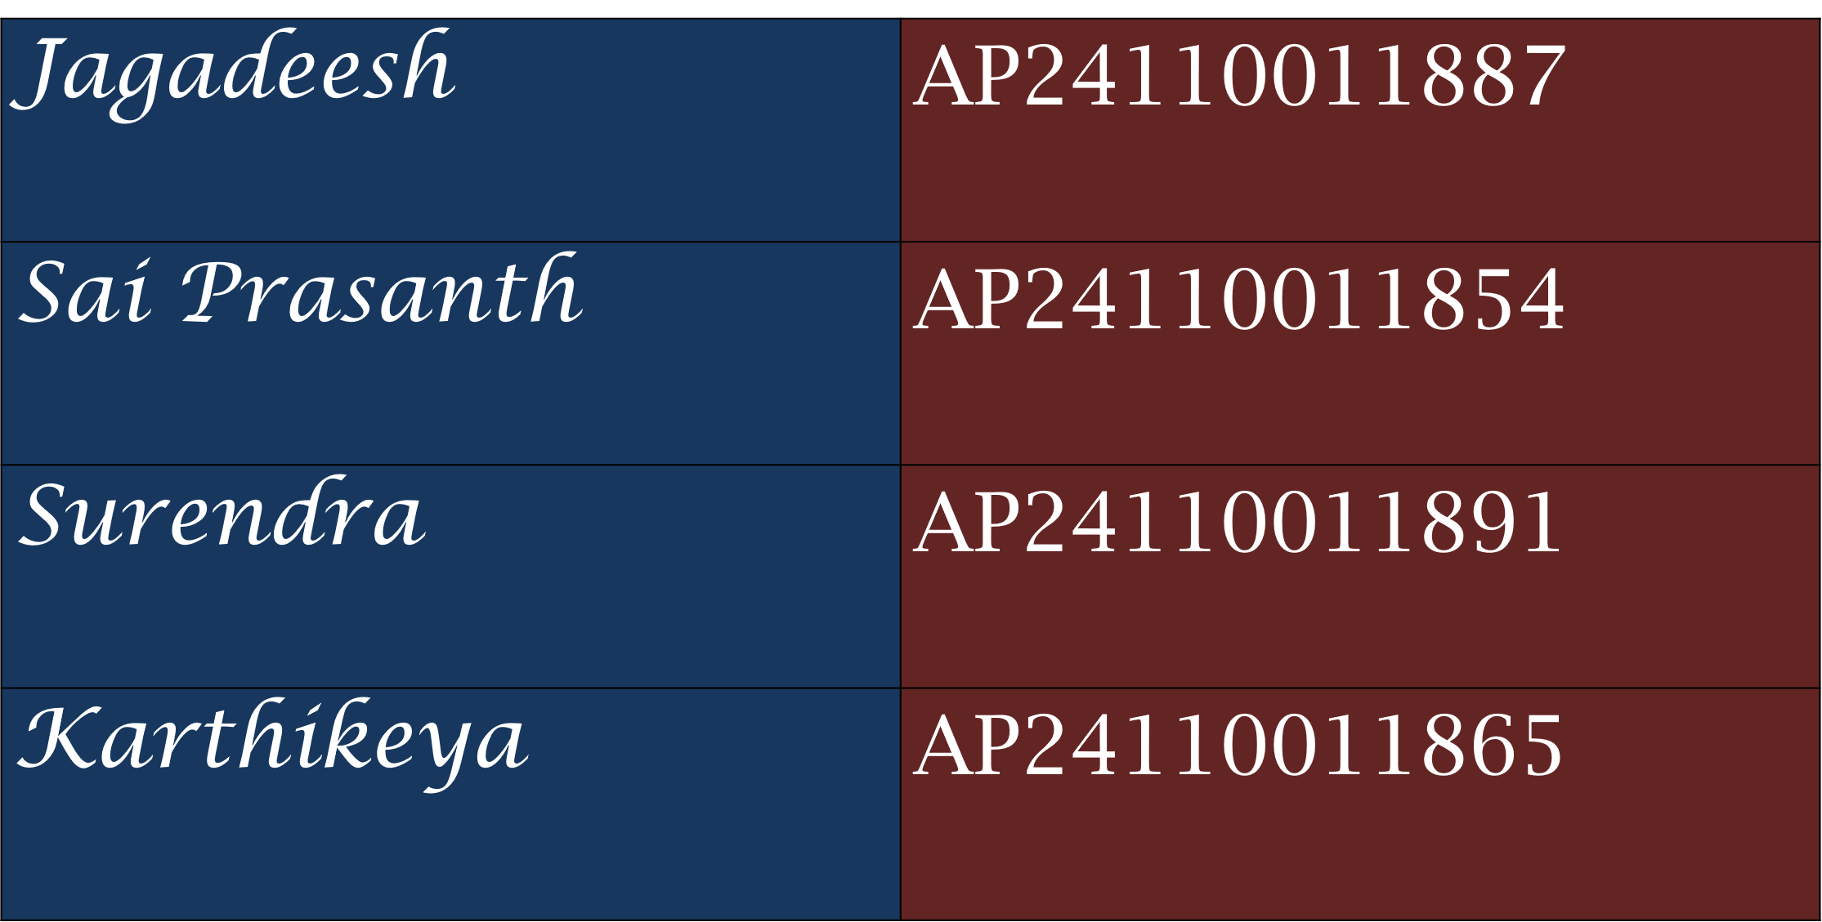

Slide 3
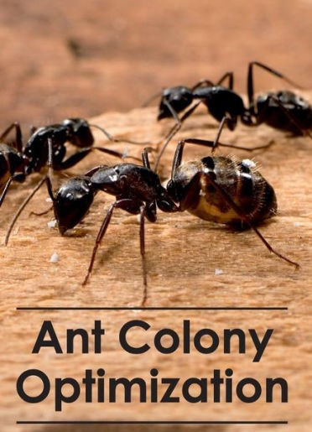
Introduction
Route optimization is essential in logistics and delivery systems
Goal: minimize travel distance/time
Traditional methods fail as number of delivery points increases
Need for intelligent, nature-inspired optimization

Slide 4
Problem Statement
Deliver to multiple locations in shortest possible route
Equivalent to Travelling Salesman Problem (TSP)
Large combinations → exponential complexity
Need an algorithm that finds near-optimal paths efficiently

Slide 5

What is ACO
Ant Colony Optimization is a nature-inspired metaheuristic
Based on real ants finding shortest path using pheromones
Uses probabilistic decisions + pheromone learning
Suitable for complex routing problems like delivery networks

Slide 6
Biological Inspiration
Ants wander randomly to find food
Shorter paths get stronger pheromone trails
Other ants follow stronger pheromone → best path emerges
ACO simulates this collective intelligence

Slide 7
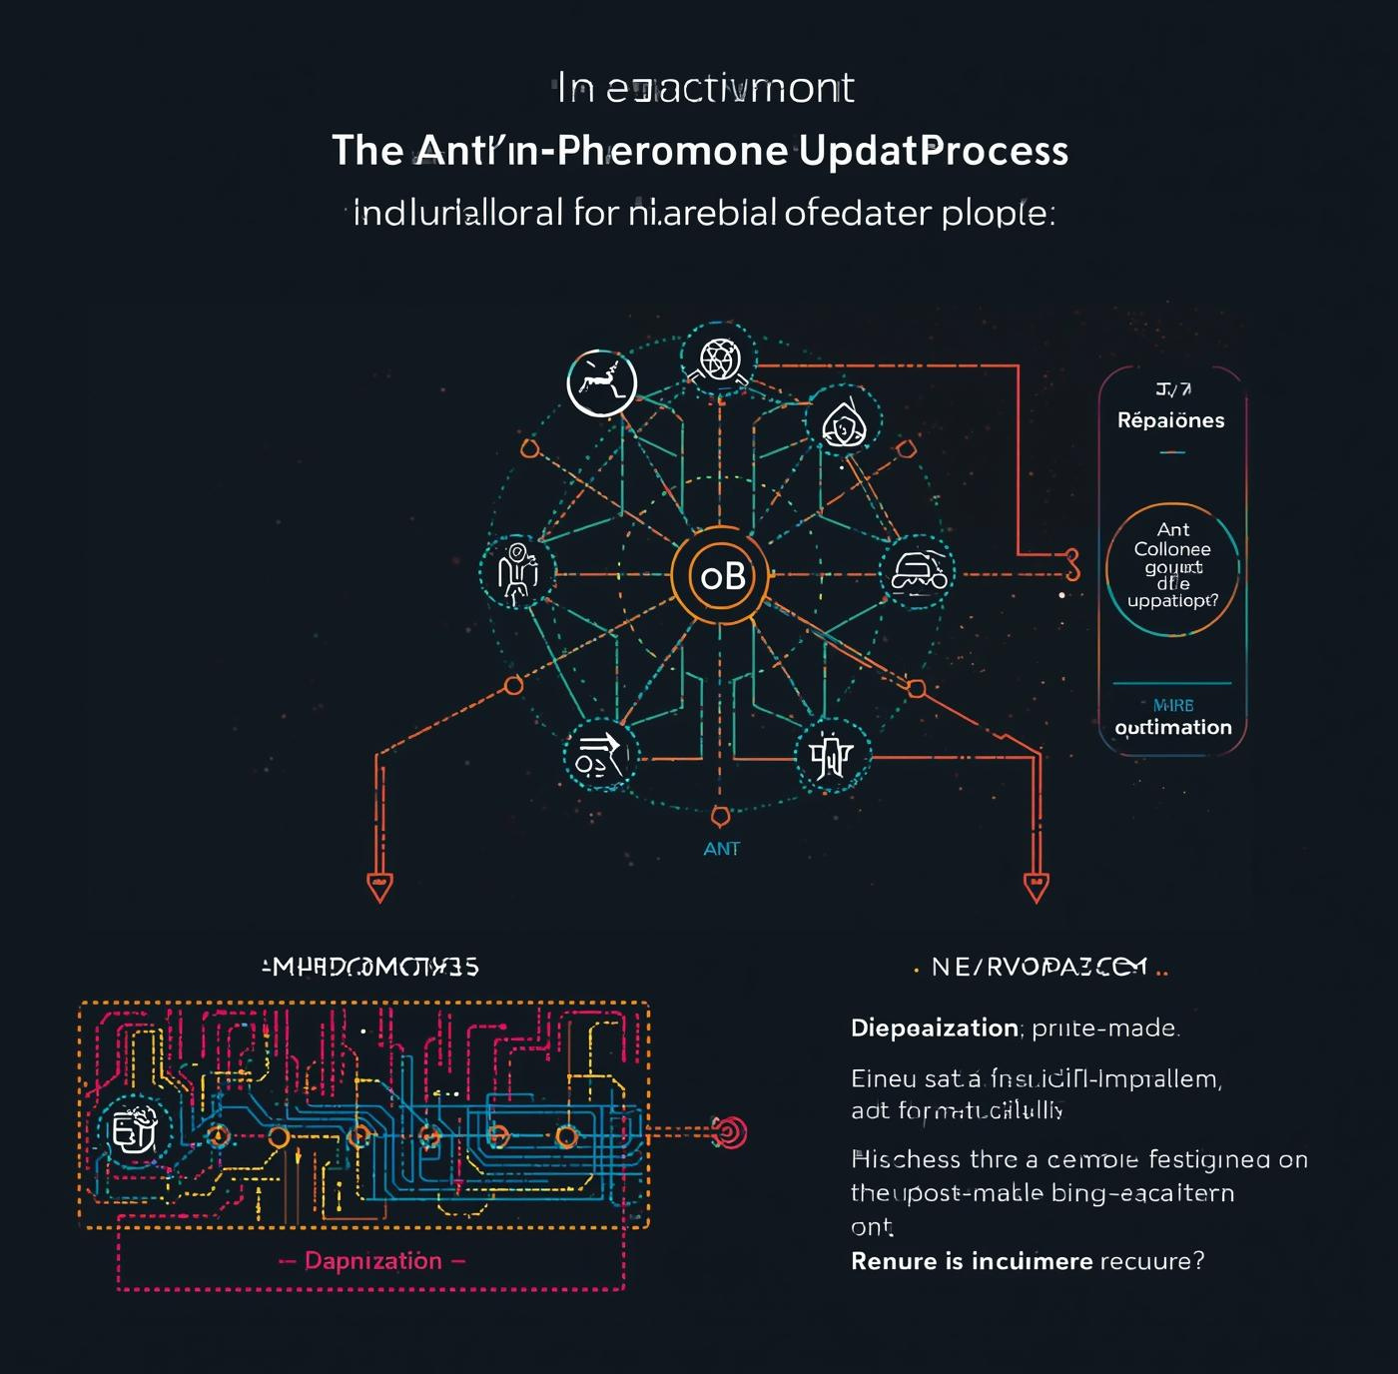
ACO WORKFLOW
Initialize pheromone on all edges
Place ants on cities/delivery points
Ants build routes based on probability
Evaluate each route
Update pheromone
Repeat for many iterations until convergence

Slide 8
ACO Algorithm Components
Pheromone (τ): indicates strength of a path
Heuristic (η = 1/distance): visibility of a good path
Parameters:
α: pheromone importance
β: heuristic importance
ρ: evaporation rate
Q: pheromone deposit
Probability-based next-city selection

Slide 9

ACO Pseudocode
Initialize pheromone for all edges
For each iteration:
Every ant constructs a complete tour
Calculate tour cost
Update best tour
Evaporate pheromone
Add pheromone for good tours
Return best path

Slide 10
Project Implementation
User clicks on canvas to add delivery points
Each ant constructs a route visually
Pheromone trails shown using line transparency
Best route highlighted
Implemented using C, CPP

Slide 11

Experiments & Results
Tested with multiple random delivery points
Ants gradually converge to shorter paths
Pheromone intensifies on optimal edges
Best route emerges clearly after iterations
Histogram of best distance continuously improves

Slide 12
Why ACO is better than other Algorithms
Works well for large, complex route networks
Avoids local minima using evaporation
Learns from collective behaviour of ants
More flexible than traditional algorithms like Dijkstra/BFS
Produces near-optimal solutions with less computation than brute force
Performs better than Genetic Algorithm in many TSP cases
Ideal for dynamic delivery routes (traffic, new points, etc.)

Slide 13


